Slide 1
Ecosystem management trade-offs and dynamic reference points
Ken H Andersen

Slide 2
Modelling single stock demography
growth
mortality
Reproduction

Slide 3
Single stock simulator
http://stockassessment.org/spectrum
Biomass
Fishing mortality
Recruitment
Yield

Slide 4
Reference points
F_{msy}
Yield
Fishing mortality
Maximum weight (g)

Slide 5
Fish community
10
0
Plankton
10
-1
10
-2
10
-3
Food
10
-4
Numbers
-5
10
Mortality
10
-6
10
-7
10
-8
10
-9
10
-10
0.1 g
10 g
1 kg
100 kg
Individual weight
Andersen and Pedersen, Proc. Roy. Soc. London B (2010)

Slide 6
Ecosystem effects
10
0
Plankton
10
-1
10
-2
10
-3
10
-4
Numbers
-5
Fishing
10
10
-6
10
-7
10
-8
10
-9
10
-10
0.1 g
10 g
1 kg
100 kg
Individual weight
Andersen and Pedersen, Proc. Roy. Soc. London B (2010)

Slide 7
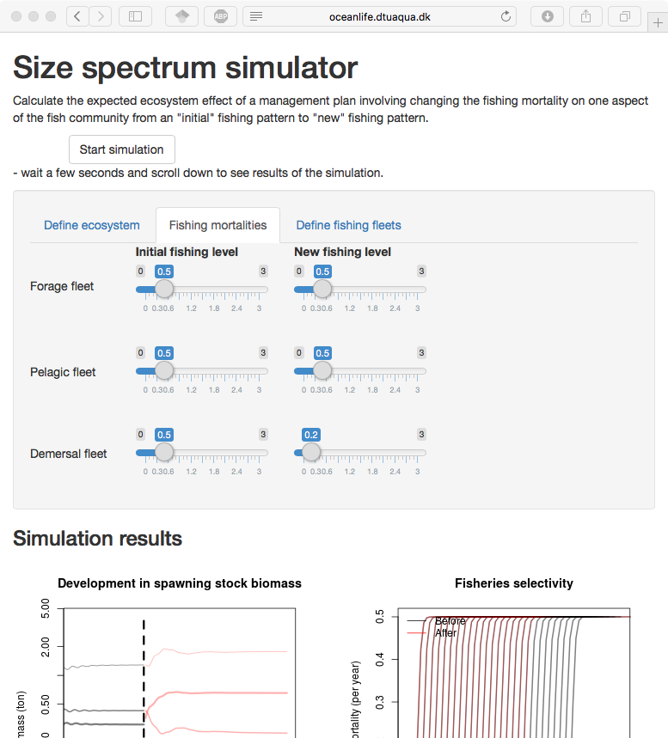
Web-based simulation: http://oceanlife.dtuaqua.dk/cspectrum

Slide 8
Biomass
Profit
Fraction < F_{lim}
Yield
0
1
2
3
Fishing mortality
1) We can get double yield!
Biomass
2) but in an impoverished sea
10
3) Conservation and $ not necessarily in conflict
1
0.1
4) Reference points are dynamic, in particular for small species
10 g
100 g
1 kg
10 kg
Maximum weight
http://stockassessment.org/spectrum
http://oceanlife.dtuaqua.dk/cspectrum
Reference points
10 g
100 g
1 kg
10 kg
Andersen et al, Ecol. App (2015)

