Slide 1
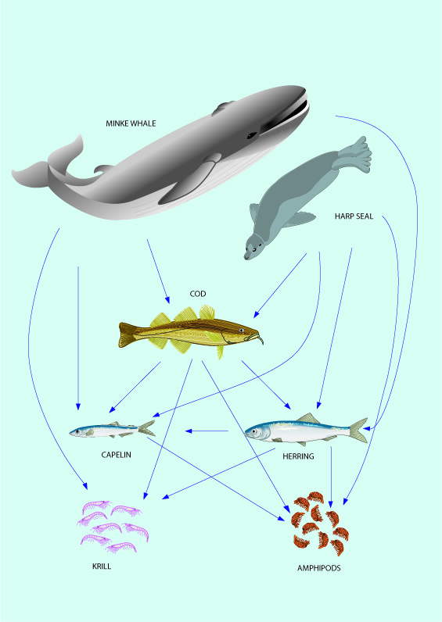
Case studies with specific Density Dependent calculations (PROST-type calculations)
Rob van Gemert and Henrik Sparholt

Slide 2
PROST (PROjections STochastic)
Stochastic projections of an age structured population model
Developed for evaluating a harvest control rule for Northeast Arctic cod in AFWG (the 3-year rule)
Customizable and extendible. It can be used generally for making single-species, single-fleet, single-area projections
Incorporation of density dependence in recruitment, growth, mortality, and maturity

Slide 3
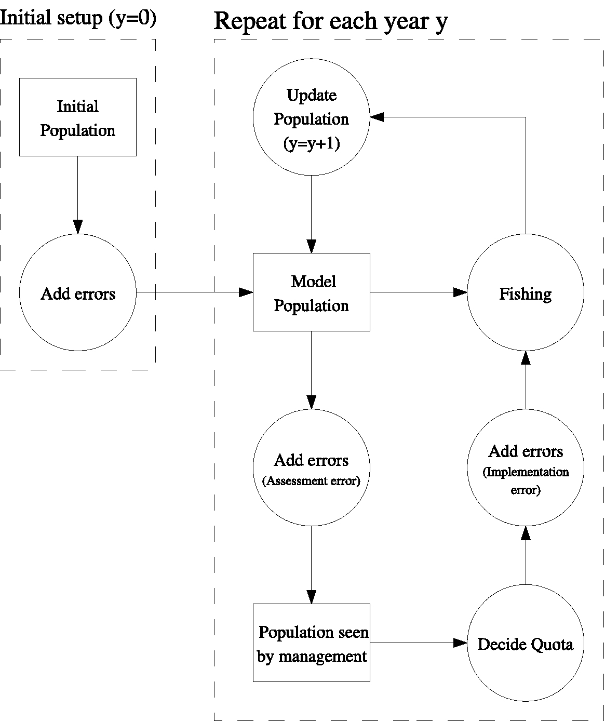
A single model realisation

Slide 4
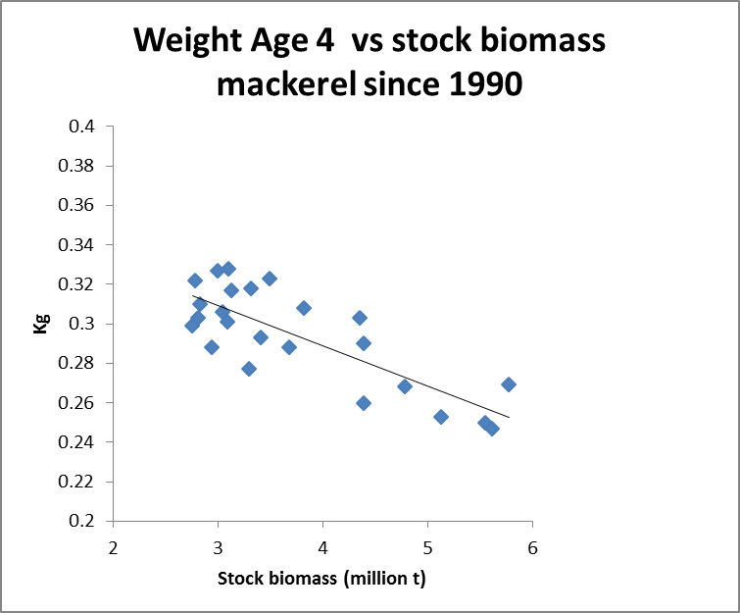
Example – growth

Slide 5
North Sea cod

Slide 6
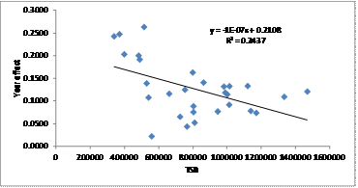
Growth
Density dependent growth. The “Year”-parameter from Cook et al. (1999) plotted against total stock biomass (TSB in unit tonnes) for North Sea cod.

Slide 7
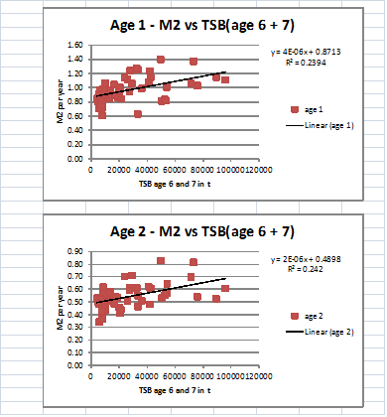

Slide 8
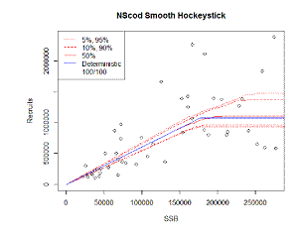
Other input – SR model
From WKMSYREF2 (ICES 2014a)

Slide 9
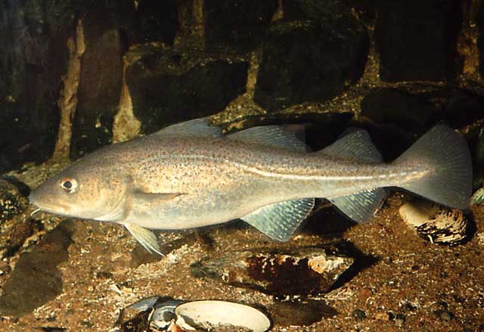
Example:
  Yield
  vs
  Fishing pressure
North Sea cod

Slide 10
Northeast Arctic cod

Slide 11
Northeast Arctic cod
Density dependence in growth, maturity and cannibalism taken into account
ICES. 2017. Report of the Working Group on Inter-benchmark Protocol on Northeast Arctic Cod (2017), 4–6 April 2017, Copenhagen, Denmark. ICES CM 2017/ACOM:29. 236 pp.
Northeast Arctic cod

Slide 12
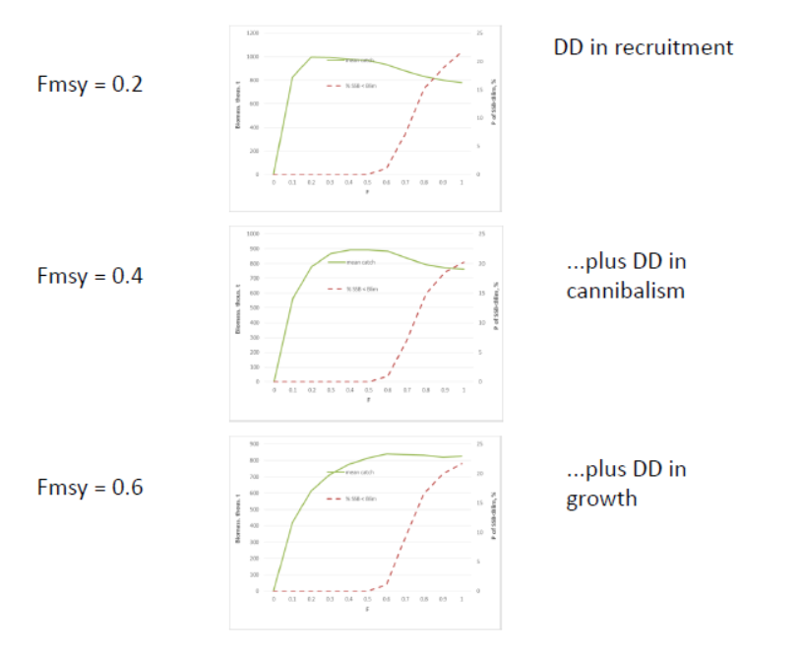
Example:
  Yield
  vs
  Fishing pressure
Northeast Arctic cod

Slide 13
Northeast Arctic cod
If fishing at F = 0.20 you will:
  Miss sustainable catch of about 0.25 mio t per year
  Have an SSB which is 0.7 mio t larger than needed. This extra SSB will predate on e.g. capelin, and in general tap the ecosystem for a substantial part of its biological production

Slide 14
Cod at Iceland

Slide 15
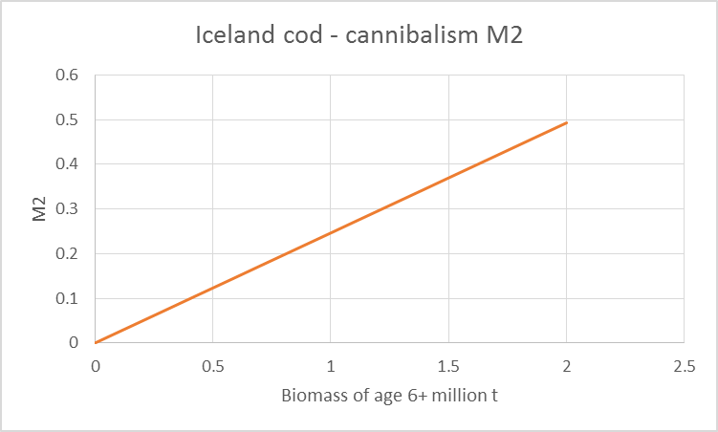
Cod at Iceland
Density dependence in growth from Danielsson et al 1997
Cannibalism: based on Barents Sea cod (Bogstad et al, 1994; ICES IBP Arctic cod report 2017, WKARCT 2015)
Predation mortality (M2) of age 3

Slide 16
Example:
Model | Fmsy | Variability in TAC by year according to Key-run | Catch according to Key-run ‘000 t | SSB according to Key-run ‘000t | TSB according to Key-run ‘000t
Key-run | 0.70 | 55% | 330 | 345 | 1170
Key-run without DD growth | 0.65 | 38% | 330 | 367 | 1193
Key-run without cannibalism | 0.55 | 24% | 323 | 429 | 1263
Key-run without cannibalism and DD growth | 0.40 | 15% | 305 | 568 | 1398
F current = 0.26 | - | 13% | 268 | 803 | 1620
Cod Iceland

Slide 17
Northeast Atlantic mackerel

Slide 18
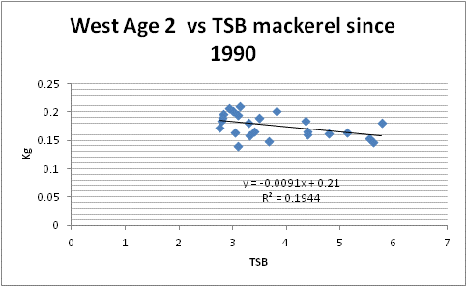
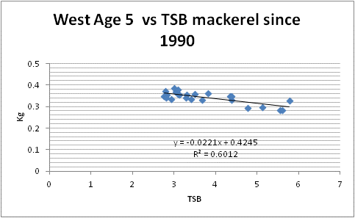
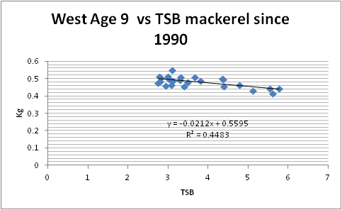
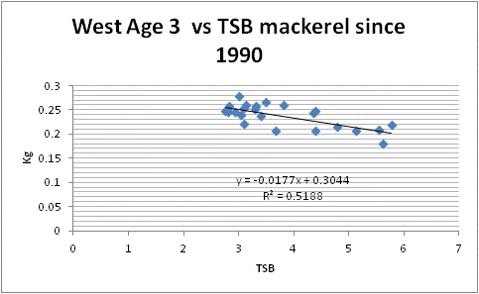
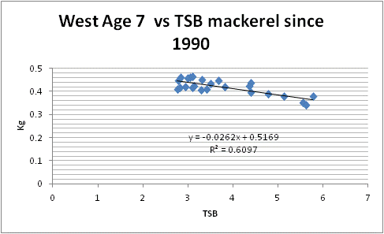
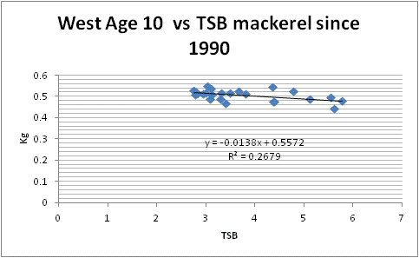
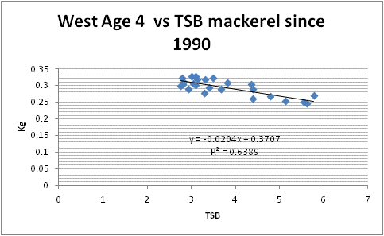
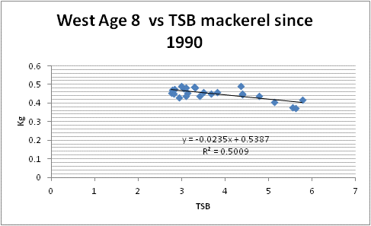
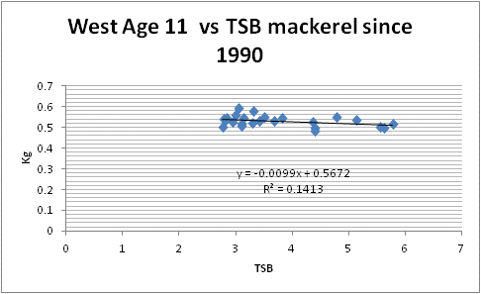
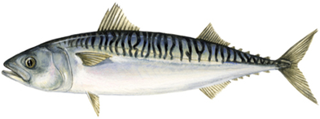
Density dependent growth
Data from WGWIDE

Slide 19

Simulation scenarios | Fmsy | SSB at Fmsy (kt) | MSY (kt) | SSB with F=0 (kt) | TAC variability from year to year | Risk to get below Blim
No density dependence | 0.30 | 3300 | 730 | 8380 | 10% | <<5%
Density dependent growth | 0.40 | 2900 | 790 | 6890 | 11% | <<5%
Cannibalism low, but if included, will give an even higher Fmsy

Slide 20
Baltic sprat

Slide 21
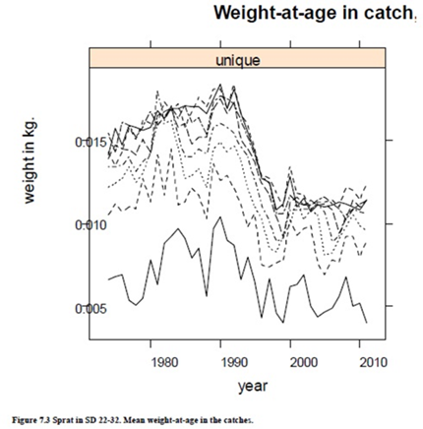
Baltic sprat
Individual growth is density dependent

Slide 22
Baltic sprat
Density-dependent growth

Slide 23
Conclusion
F_{MSY} values
Stock | ICES 2016 | Direct calculations
Cod Icelandic | - | 0.70
Cod North Sea | 0.33 | 0.70
Cod Northeast Arctic | 0.40 | 0.60
Mackerel | 0.22 | 0.40
Sprat Baltic Sea | 0.26 | 0.45

Slide 24
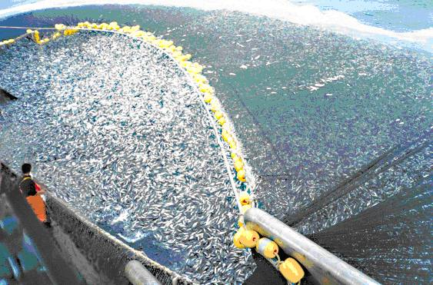
Thank you !

