Slide 1
Varying productivity, FMSY and implications for sustainable levels of fishing
M. Joanne Morgan

Slide 2
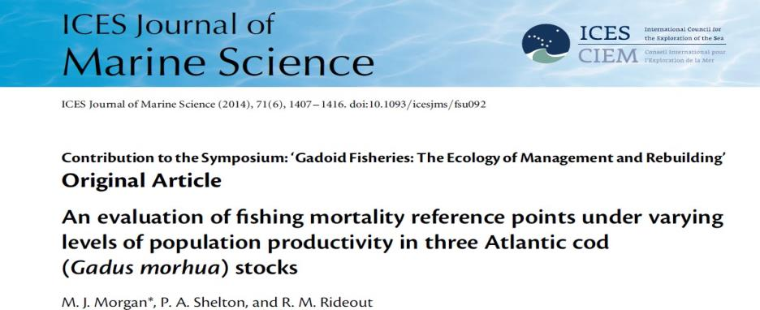
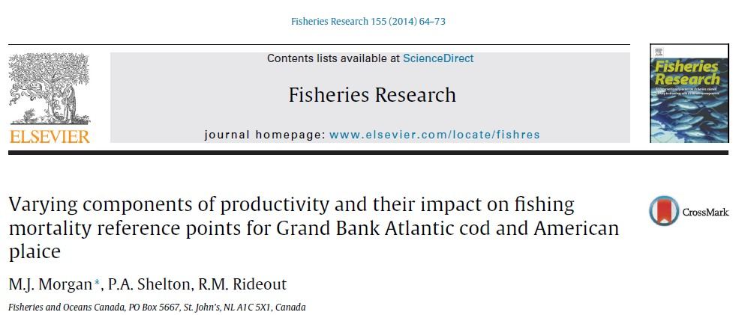
Notes:
Talk about the ideas from these papers and illustrate with NEA cod as example - more interesting than just a repeat of what is in the papers and hopefully a stock that is of more interest to you

Slide 3
Components of productivity
Growth (weight at age)
Maturity
Recruitment
Mortality
These determine Spawner per Recruit and Recruits per Spawner

Slide 4
Together RPS and SPR completely define stock productivity
These can vary as a result of compensation and/or environmental variation

Slide 5
RPS
mortality from egg to recruit
number of eggs per spawner
SPR
proportion mature at age
growth
fecundity
mortality

Slide 6
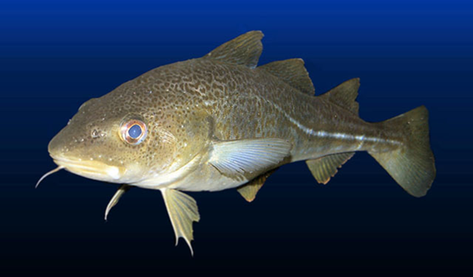
NEA cod
Use an example to show the variation in SPR and RPS – is there compensation
How this translates into variation in productivity
What is the impact on how much fishing a population can sustain

Slide 7
Both SPR (at F=0) and RPS have varied greatly in NEA cod

Slide 8
Compensatory?
Perhaps not for SPR
We have found it to be an important component of compensation in other stocks

Slide 9
Compensatory?
There is some evidence of compensation in RPS – especially clear at high SSB

Slide 10
Some evidence of compensation in RPS
Large variation in both SPR and RPS at low stock size –environmental impact?
Haven’t looked at this but we have found this in other stocks

Slide 11
Potential Population Growth Rate
Potential annual % SSB growth at F=0 when stock is below the break point of the hockey stick s/r and has a stable age composition as measure of productivity

Slide 12
For a population to grow SPR > 1/RPS
Calculated G0 for 17 years at varying SPR-1/RPS
Determined the relationship between G0 and SPR-1/RPS
Used this relationship to estimate G0 for all years to see how much productivity has varied

Slide 13
GAM
Family: gaussian Link function: identity Formula: G ~ s(diff)
𝛿 𝑖𝑠 𝑆𝑃𝑅−1/𝑅𝑃𝑆 or diff Approximate significance of
smooth terms
edf F p-value
s(diff) 1.125 8.336 0.0106

Slide 14
Potential growth rate varied from 0.14 to 0.42
Unlike many stocks NEA cod did not have any years when the stock would have declined even without fishing

Slide 15
May be some compensation – at least at high SSB
-this means very large SSB has low productivity
- at low stock size both high and low G0

Slide 16
Productivity varies a lot in NEA cod
May be compensatory at least at high SSB
What are the consequences for sustainable levels of fishing?

Slide 17
Calculated FMSY using parameters for the highest G0 (1988) and lowest G0 (2013)
Starting with the same population numbers at age fished with the 2 FMSY on the population with either the high or low levels of productivity

Slide 18
Population decline of 60% in 10 years if productivity is low and F is high
And only 20% of what it would have been fishing at low F

Slide 19
BUT if fish at low F when productivity high great loss in yield

Slide 20
Conclusions
Productivity highly variable
This results in variation in levels of sustainable fishing
If this is not accounted for it can result in stock decline or lost fishing opportunities
Some of the variation may be compensatory which will result in lower productivity at high stock size
These higher SSB may be able to sustain higher F for some (short) period of time
Biggest problem is when stock size is low and so is productivity
NEED TO ADJUST F REFERENCE POINTS FOR PRODUCTIVITY (requires biology) AND STOCK SIZE

