Slide 1
Density-dependent growth in North Atlantic fishes: exception or the rule? by Jan Horbowy*, Jeremy Collie**, Adrien Tableau** *National Marine Fisheries Research Institute, Gdynia, Poland **Afiliation to be inserted
ICES, ASC 2018, Q:452

Slide 2
Introduction
ICES basis of the fisheries advice:
Maximum sustainable yield (MSY)
a) within a precautionary approach (PA)
b) integrating ecosystem-based management
Standard ICES approach to derive F_{MSY}:
Long-term stochastic simulations with age-structured model (advice rule, S-R relationship, precautionary approach included)
Constant: growth rate, maturity, natural mortality, fishing pattern
However, growth rate may change with change of stock size (next slide example)

Slide 3
Baltic sprat – an example of dependence of growth on stock size

Slide 4
Sprat: influence of density dependent effects on MSY */
(black=constant growth, red=DDG)
Results of long-term stochastic simulations, in which growth was density dependent
MSY & Fmsy much higher when DDG included
DDG would also effect estimates of PA reference points
Thus, checking evidence for DDG (and including DDG in simulations) is important for estimation of MSY parameters
*/ Horbowy, J., Luzenczyk, A. 2017. Effects of multispecies and density dependent factors on MSY reference points: Example of the Baltic Sea sprat. Can. J. Fish. Aquat. Sci. 74: 864–870. dx.doi.org/10.1139/cjfas-2016-0220

Slide 5
Stocks considered & Data
53 stock were analysed:
- 43 stocks from European waters (mainly cod, haddock, saithe, whiting, herring, sole, plaice)
-10 US stocks from north-west Atlantic (cod, haddock, flatfishes from Gulf of Main & Georges Bank)
Data
Weight at age data: from ICES WGs; where possible taken as WEST (weight in the stock) , otherwise WECA (weight in the catch)
Biomass (TSB, SSB) and recruitment: most recent ICES assessment (2017 or 2018)
USA data Jeremy please help

Slide 6
Methodological problems
In simple statistical analysis of the type
weight = function of biomass
spurious correlations (positive) may occur as weight is present at both side of the above equation.
It may be illustrated in simulations by:
- generating random weights and random stock numbers (through random recruitment)
- relating different measures of growth change with stock biomass.

Slide 7
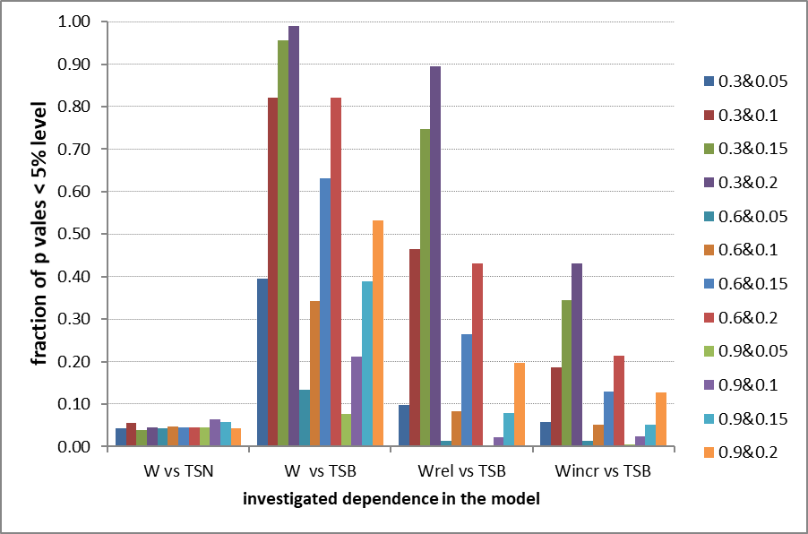
Methodological problems
The following weight models were considered:
weight as a linear function of TSN (total stock numbers), W vs TSN
weight as linear function of TSB (total stock biomass), W vs TSB
relative change in weight as linear function of TSB, Wrel vs TSB
Weight increment as linear function of TSB, Wincr vs TSB
Conclusion:
Modeling weight increment gives relatively low number of spurious positive correlations between growth & biomass
Colors represent different options for weight & recruitment variance

Slide 8
Methods, some details
Andersen & Ursin (1977) differential form of von Bertalanffy growth equation
$$\frac{dw}{dt}=vhfw^{2/3}−kw$$
w=weight, f=feeding level, h=anabolism coefficient, k=catabolism coefficient, v=fraction of assimilated food used for growth, Q=parameter.
$W_{inf}={(\frac{vhf}{k})}^{3}$,
$f=\frac{food}{food+Q∗Stock}$
From Ford-Walford equation (K=k/3)
${∆w=w}_{t+1}^{1/3}−e^{−K}w_{t}^{1/3}$=${W_{inf}}^{1/3}(1−e^{−K})$=$\frac{vhf}{k}(1−e^{−K})$
The term ${∆w=w}_{t+1}^{1/3}−e^{−K}w_{t}^{1/3}$ may be called “normalised” increment as it does not depend on age. However, it depends on stocks size (through f). Taking reciprocals leads to
$$({∆w )}^{−1}=α+β∗Stock$$
(reciprocal of „normalised” increment as linear function of stock size)
where 𝛼, $β$ are parameters.

Slide 9
DDG: options considered
Four options of possible density dependence in growth in relation to biomass & recruitment were considered :
average (over ages) yearly increment in weight as dependent on
TSB (total stock biomass), yIncr vs TSB
SSB (spawning stock biomass), yIncr vs SSB
average increment in weight over entire cohort as dependent on recruitment abundance, ycIncr vs R
average relative weight over entire cohort as dependent on TSB (similar to Cook et al. 1999, J. Northw. Atl. Fish. Sci., Vol. 25: 91–99), ycRelW vs TSB

Slide 10
Results
Negative DDG - summary over the models as % of occurrence
Summary over groups of species (families):
gadidae 33 %
flatfishes 25 %
clupeidae 55 %
Stock dynamics measured as range or CV of biomass (recruitment) did not have clear effect on DDG

Slide 11
Results
Other summaries Jeremy please help

Slide 12
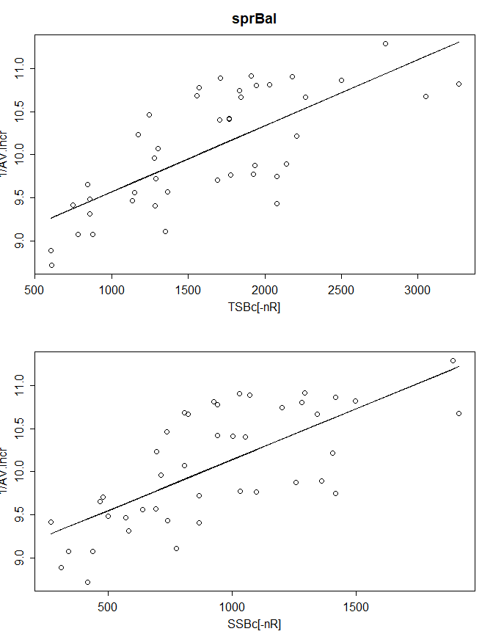
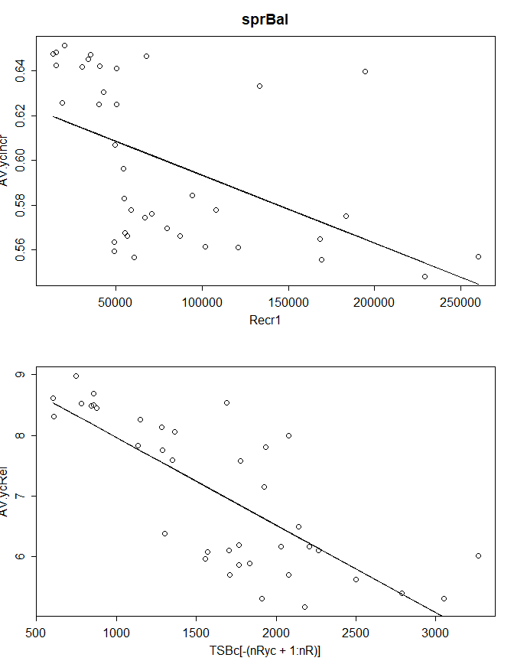
Results
Example of strong negative DDG – Baltic sprat
Reciprocal of yearly increments vs biomass, R² ca. 0.5
Year class increments vs
Recr. & biomass, R² ca. 0.3-0.5

Slide 13
Conclusions
DDG occurs for quite big percentage of stock
over 30% for given model
almost 50% for at least one of the models
Next conclusion, Jeremy please help
Further investigation: testing other error structure in fitting the models (relevant here ???)

Slide 14
Thank you
☺

Slide 15
Methods
Two measures of growth changes were considered :
Average (over ages) „normalised” increment in weight within year (t) or year-class (yc)
${Av.Incr}_{t}{{={average}_{over a}(∆w}_{t,a}), }_{}^{ }$
${Av.Incr}_{yc}{{={average}_{over yc}(∆w}_{t,a}), }_{}^{ }$
where average „normalised” increment in weight at age a in year t, ${∆w}_{t,a}$, is defined as
${{∆w}_{t,a}=w}_{t+1,a+1}^{1/3}−e^{−K}w_{t,a}^{1/3}$ (red part shows the difference from standard definition of increment)
Reciprocal of such increment may be considered as linearly dependent on stock size (see slide 11), the multiplier $e^{−K}$ makes it „independent” on age, the power 1/3 leads to linearity
B. Relative weight at age (in relation to average weight at age over entire time series)
$${RELw}_{t,a}{{=w}_{t,a}/{{average}_{over t}(w}_{t,a}), }_{}^{ }$$

Slide 16
Steps in the analysis
Simple Linear models were applied (normal distributions, constant variance, ..., GLM may be considered if necessary)
First all data points for given stock were used in the data analysis and model fit. The produced output consisted of
Plots of relative growth and normalised increment by ages over years and their variance (SD)
Different measures of consistency (inconsistency) of growth changes (within years or cohorts): SD at year, correlations (pairs), bubbles plots
Plots of observations and fitted relationships
Tables with linear model fits, including
Tests for normality
Tests for outliers; in addition identification of residuals exceeding 1st or 3rd quartile -/+ 1.5 *IQR (inter quartile range)
Diagnostics on graphs: residuals distribution, qq plots, Cook’s distance, dffits, dfbetas

Slide 17
Steps in the analysis (cont.)
3. Basing on above diagnostics main action taken was to shorten range of considered age groups (usually excluding the oldest and/or youngest ages, often poorly sampled, showing higher variability)
4. Analysis was repeated on shortened age range and eventual outliers excluded.
5. Such analysis enabled to find significant density dependence in mackerel not seen when all data were used

