Slide 1
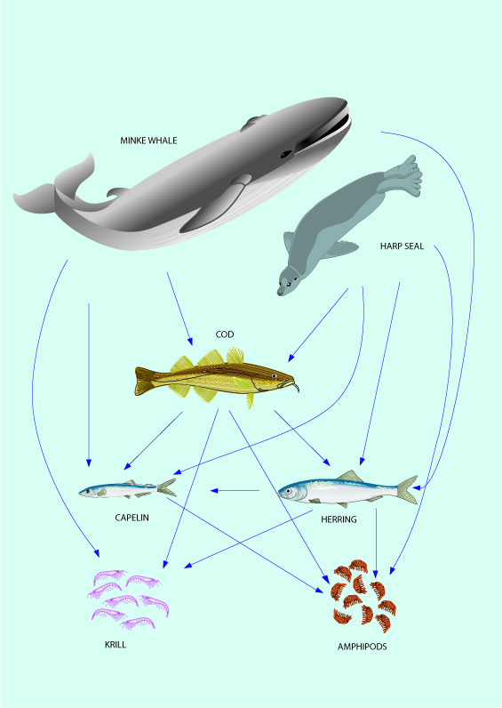
Eco-system Fmsy - The two methods
.

Slide 2
Two basic ideas
GLM type approach to ”spread” the available ecosystem Fmsy to other stocks
Use of Surplus Production Models on the existing stock assessment time series of catch, F and SSB

Slide 3
GLM type analysis to “export” ecosystem Fmsy
General linear Models (GLM) models will be used to “export” ecosystem Fmsy from stocks where these available from multispecies and ecosystem models and density dependent growth and maturity (and cannibalism) studies, to stocks where such models and studies are not available. The link between the stocks is envisioned to be life history parameters and species groups.
The candidate life history parameters for such analysis are Lmax, age at 50% maturity, Von Bertalanffy K, Steepness in Stock-recruitment curves, relative increase in weight from age-at-“50% maturity” to age-at-“50% maturity” +1year. As we here are dealing with data rich stocks, such data are easily available or can easily be calculated.
A multiplicative model like, will be applied:
Log(Fmsy (s)) = a +“Species group”(s) + L(s)
Where s is a given stock, a the intercept, “Species group” is species group like for instance “cod” or “plaice”, and L is the life history parameter, for instance Lmax. Fmsy will be expressed in the “common currency” unit.

Slide 4
Surplus production model estimates of Fmsy
The so-called summary tables from the ordinary assessments with time series of catch, SSB, and F. F can be used as a measure of fishing effort and SSB as an index of stock size.

Slide 5
Filtering stocks
SPMs are not working well if there is no dynamic range in the time series data.
Furthermore, in cases where there are large dynamic ranges in data SPM does not perform well neither, if these variations is due to environmental variations and not varying fishing pressure.
F has to be the main driving force for the variation in the stock.

Slide 6
Criteria for leaving out of the SPM analysis:
1. Stock unit not well defined, e.g. cod WScot.
2. Catch data far from reliable.
3. Stock that have demonstrated large changes in carrying capacity.
4. Stocks with one or a few very large year classes in its historical time series are not suitable because the historical stock development will be driven by these year classes and mask the density dependent dynamics of the stock, e.g. W horse mackerel, maybe North Sea haddock and NSSP herring).
5. Stocks with suddenly strong parasites or diseases events or starvation – or at least these periods should be left out, e.g. cod Baltic SD2532.
6. Stocks with little dynamic range in catch and SSB.
7. Stocks with short time series.
8. Stocks with large changes in exploitation pattern over the time span considered, e.g. NSSP herring.
9. Stocks which gives very different temporal stock biomass development using surplus production models (like by Froese et al 2016) than the ICES estimated temporal biomass development.
10. Stock like cod WScot, where stock development obviously driven by some (unknown) environmental factors that goes clear against normal population regulation mechanisms. For cod WScot the stock is increasing in spite of increasing catches over time.
11. Stocks where predation pressure has varied strongly over time, e.g. Baltic sprat due to large changes in the cod SD2523 stock. Maybe a shorter time series can be used.

Slide 7
SPM shape
Selecting the shape of the production curve (whether Bmsy/B0 is 0.5 as in Schaefer or 0.33 as in Pella-Tomlinson, or 0.4 in Thorson et al. (2012, Can. J. Fish. Aquat. Sci. Vol. 69, 2012), or variable by species) is a point to be worked on in the project.

Slide 8
SPM already done for all stocks in ICES
Froese, R., Demirel, N., Gianpaolo, C., Kleisner, K.M., Winker, H. 2016. Estimating fisheries reference points from catch and resilience. Fish and Fisheries, doi:10.1111/faf.12190.
Froese, R., Garilao, C., Winker, H., Coro, G., Demirel, N., Tsikliras, A., Dimarchopoulou, D., Scarcella, G., Sampang-Reyes, A. 2016. Exploitation and status of European stocks. World Wide Web electronic publication, http://oceanrep.geomar.de/34476/

Slide 9
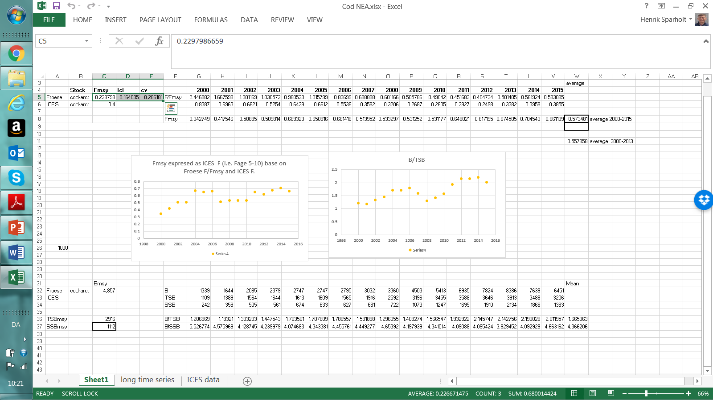
Froese et al 2016 combined with ICES absolute F -- Example NEA cod.

Slide 10
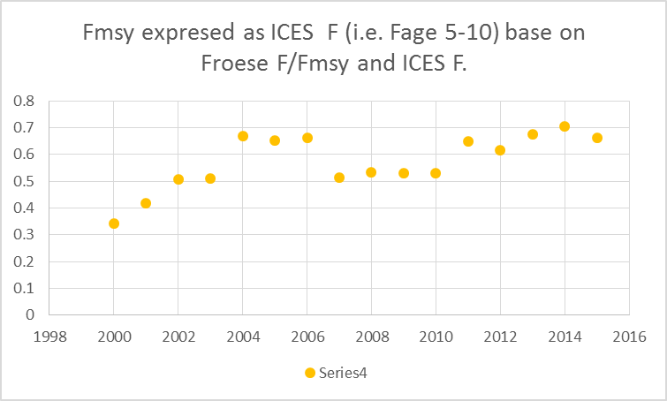
Highlighting one figure...

Slide 11
The MSY project will only deal with long lived species but the methods also useful for short lived
But short lived species are often forage fish and thus might need time series to be split into ”constant predator pressure” periods when doing SPM
For both SPM and multispecies runs: select those where predator pressure are about the current
the obtained Fmsy values will then need updates say every 5 years.

Slide 12
F ”currency”
F in SPM is referring to biomass and is an instantaneous mortality rate.
The biomasses it refers to is catch and the exploitable biomass, which is the biomass of each age group in the stock multiplied by the exploitation pattern of the fishery. Often juveniles are not exploited and therefore not part of the exploitable biomass considered here. Sometimes old individuals are also not exploited fully and thus neither fully contributing to the exploitable biomass considered in SPM, but it is to spawning – so a bit difficult.
Thus, F in SPM reflects both reduction in stock numbers of each cohort, biomass growth of individuals and recruitment of juveniles into the exploitable stock biomass.

Slide 13
What is the link between F in ICES and in SPM models?
Very few studies published
However we only need F/Fmsy from the SPM so no real problem
...and luckily F/Fmsy is much better estimated than F in SPMs, (because one need to guess one more parameter to get F than to get F/Fmsy - for instance carrying capacity in absolute term)

Slide 14
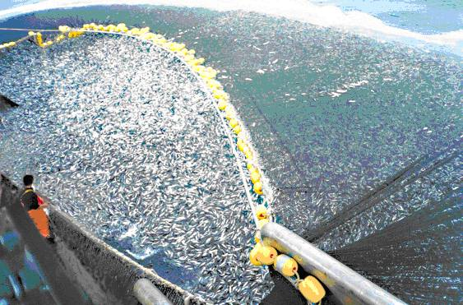
Thank you !

