Slide 1
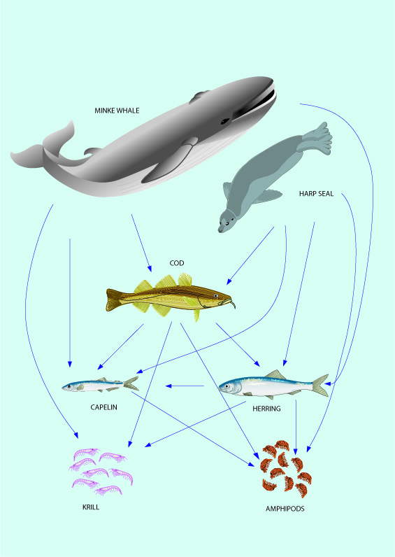

Eco-system Fmsy
Henrik Sparholt
NMTT, Dr.Sc.

Slide 2
Project
2017-2018
Conference 11-12 October 2018 with results
Funding agencies:
  Nordic Council of Ministers
  EMMF and Danish Ministry of Fisheries
  Norwegian Fisheries Research Fund

Slide 3
Key scientists
Ray Hilborn
Jan Horbowy
Petur Steingrund
Jeremy Collie
Bjarte Bogstad
Daniel Howell
Villy Christensen
Gunnar Stefansson
Henrik Sparholt

Slide 4
Objective
Come up with new Fmsy values based on ecosystem functioning:
  -- for ICES 45 data rich stocks

Slide 5
...by way of
  ”Bridging the gap” between science and scientific advice/management
  Bring multispecies and ecosystem science into Fmsy calculations

Slide 6
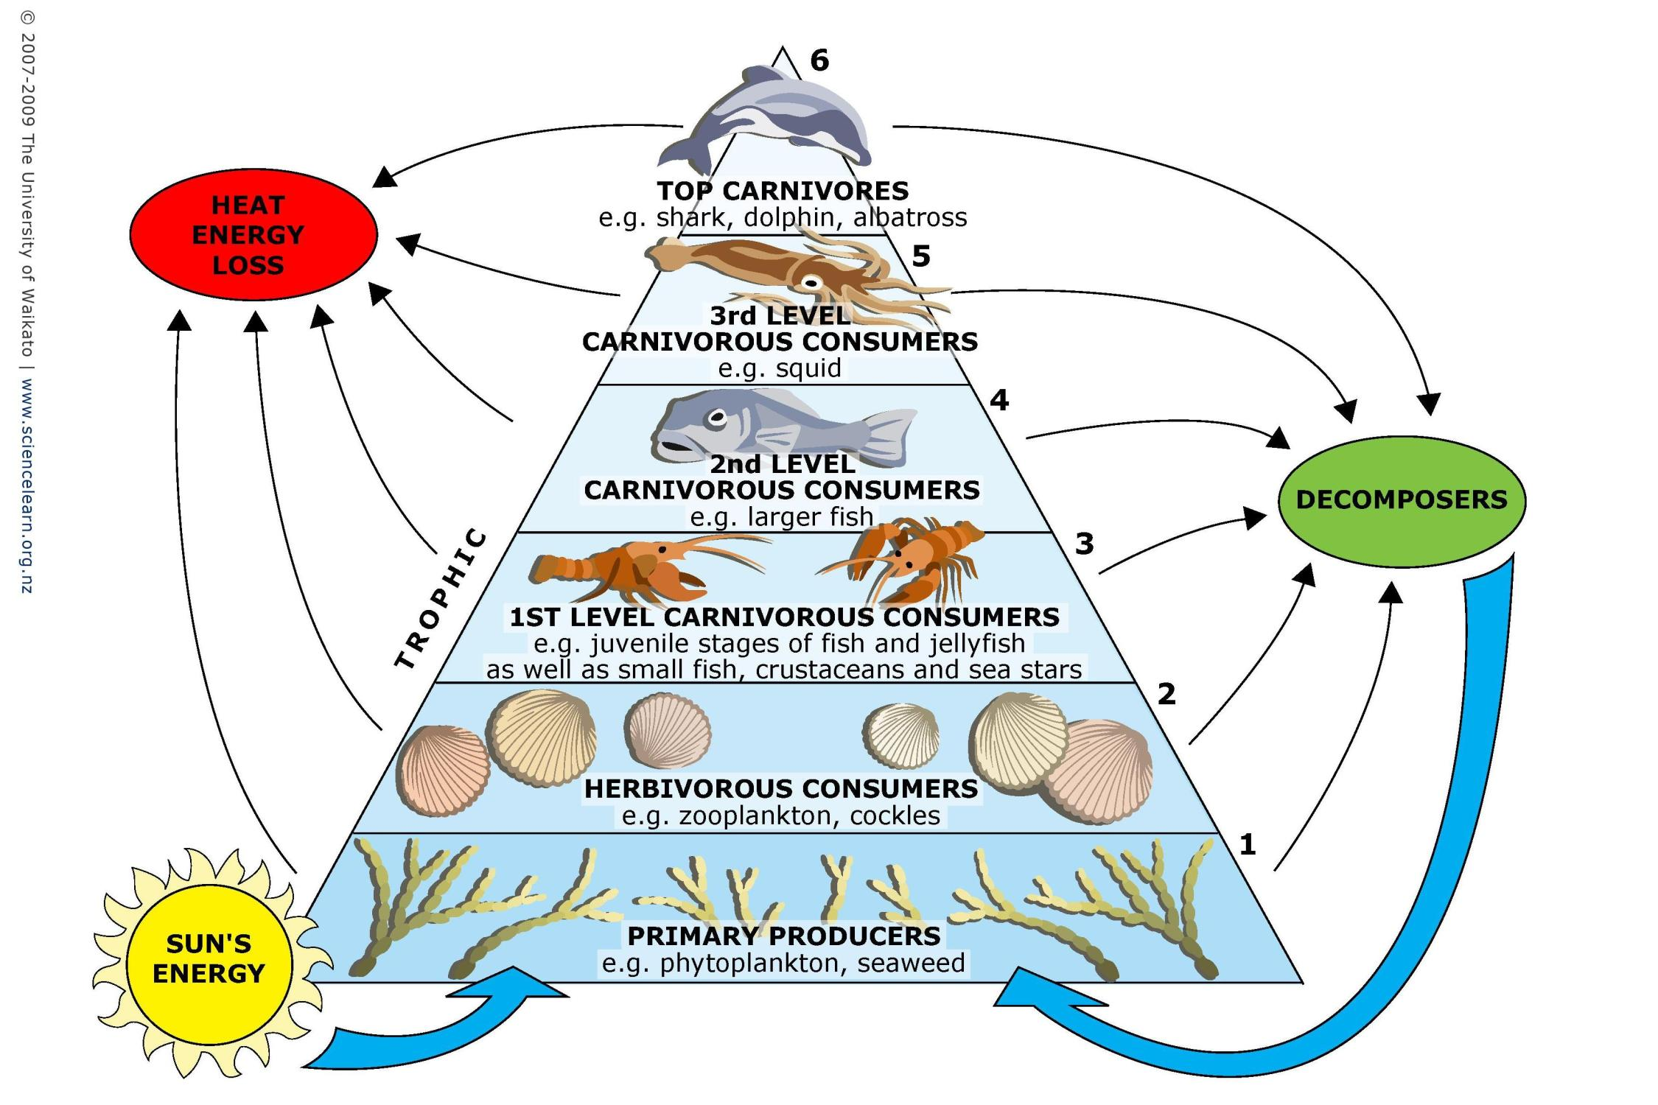
Ecosystem productivity
Notes:
Basic ecosystem concepts
The production in an ecosystem is based on primary production.
This production is moving up the food web and at each tropic level there is only a certain amount of production possible.
If the fishing is too light the fish stocks will be too large and burn too much production for metabolic maintenance (convert to C0₂) - production which could otherwise have been harvested.
If the fishing is too hard the fish stocks will be too small and not produce enough juveniles.

Slide 7
Basic ecosystem concepts
The production in an ecosystem is based on primary production.
This production is moving up the food web.
If fishing is too light: the fish stocks will be too large and burn too much production in metabolic maintenance (convert production to C0₂) - production which could otherwise have been harvested as fish meat.
If the fishing is too hard: the fish stocks will be too small and not produce enough juveniles.

Slide 8
Graham 1947, Beverton&Holt 1957, Ricker 1958, Hilborn&Walters 1992, Longhurst 2010, and many others…
Longhurst, A. 2010. Mismanagement of marine fisheries. Cambridge University Press, Cambridge, UK:
” For any level of fishery harvest to be sustainable, some or all of the biological processes contributing to production must be compensatory, i.e. increasing as stock biomass decreases…”

Slide 9
Four compensatory mechanisms –
Taken into account in current management?
Density dependent recruitment
Density dependent individual fish growth
Density dependent mortality
Density dependent maturity
√
Not yet
Not yet
Not yet
Missing any of these in Fmsy calculations will give a downward bias!
Notes:
The way ecosystem functions in relation to fish is via Four compensatory mechanisms are important for fisheries management and fish stock dynamics:
DD r means that the number of juveniles produced each year is not increased infinitely when the stock size increase, at some stage a further increase in stock does give more juveniles – or put the other way around when a fishery starts on a pristine stock, the stocks decreases but the they still produce almost the same amount of juvenlies. So it compensates by producing more juveniles by female.
DD growth of individual fish also increases when the stock decreases – the improved growth in that way compensate to some extent for the reduced stock numbers
Same with mortality – the mortality decreasse as the stock decrease and thus more will survive and thus compensate for the reduction. Especially when we have to do with speces that are cannibals as cod are this can be quite important.
DD maturity fish mature at a younger age when the stock is small –

Slide 10
...and of course, scientific advice should be unbiased
ICES Strategic Plan 2014–2018:
” …commitment to maintain ICES as a strong and independent scientific organization in order to improve its capacity to give unbiased, sound, reliable, and credible scientific advice on human activities affecting, and affected by, marine ecosystems;”

Slide 11
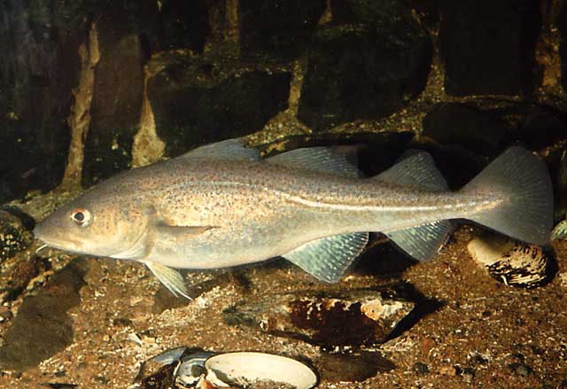
Example:
  Yield/SSB
  vs
  Fishing pressure
North Sea cod

Slide 12
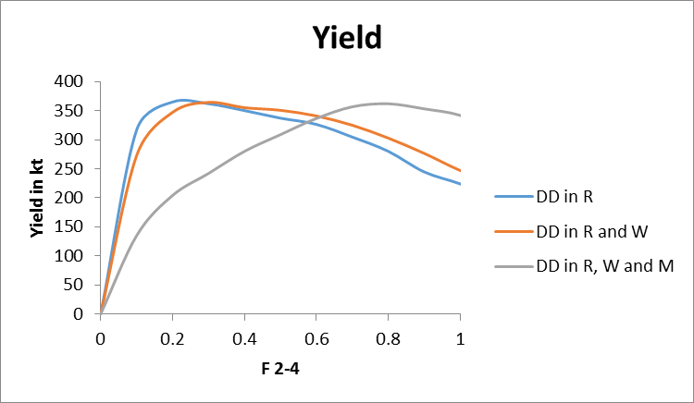
Example:
  Yield
  vs
  Fishing pressure
North Sea cod

Slide 13
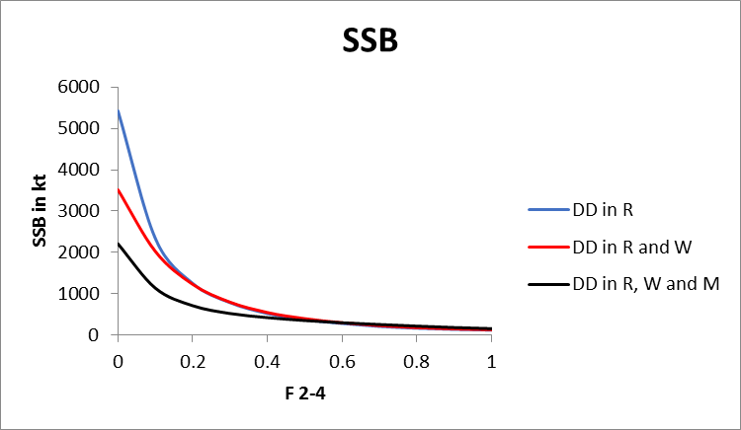
Example:
  SSB
  vs
  Fishing pressure
North Sea cod

Slide 14
“…managers are required to use the best scientific information available…”.
And ICES:
“ICES advice is produced through a process which is set up to ensure that the advice is based on the best available science and data…”
http://www.ices.dk/community/advisory-process/Pages/Basis-for-ICES-Advice.aspx

Slide 15
Available science in ecosystem functioning
  over four decades of intensive research
  hundreds of peer reviewed papers has been published
  more than 1.5 million fish stomachs analyzed
  hundreds of person-years spend on fish evacuation experiments
  a multitude of models developed.

Slide 16
Why wait another 30 years to use the obtained knowledge?
Let us pick the low hanging fruits now.
The project aim:
Bridging the ”gap between science and fisheries advice/management”.

Slide 17
Like today, managers still do not need to consider the balance between species for using the proposed set of F_{MSY} values.
The project does not aim for a full multispecies approach, …but much closer to it than the current approach.
The focus will be on adding mainly density dependent growth, maturity and (if relevant) cannibalism, to the current single species way of estimating F_{MSY}.
The lack of full multispecies approach means that the new FMSY values should only be regarded as valid for say 5 years, before being renewed. Stock sizes can for this short time period be considered reasonable constant and thus species-interactions parameters as well.

Slide 18
Two basic ideas
GLM type approach to ”spread” the available ecosystem Fmsy to all stocks
Use of Surplus Production Models - that implicitly includes all 4 density dependent elements - on the existing stock assessment time series of catch, F and SSB

Slide 19
Stock | Fmsy Current | Fmsy ecosystem
Blue whiting in Subareas I-IX. XII and XIV (Combined stock) | 0.30 | 0.4
Cod in Division Va (Icelandic cod) |  | 0.5
Cod in Division VIa (West of Scotland) | 0.19 | 0.6
Cod in Division VIIa (Irish Sea) | 0.40 | 0.7
Cod in Divisions VIIe-k (Celtic Sea cod) | 0.40 | 0.7
Cod in Subarea IV (North Sea). Divison VIId (Eastern Channel) and IIIa West (Skagerrak) | 0.19 | 0.7
Cod in Subareas I and II (Northeast Arctic cod) | 0.40 | 0.4
Cod in Subdivision Vb1 (Faroe Plateau) | 0.32 | 0.5
Cod in Subdivisions 22-24 (Western Baltic Sea) | 0.26 | 0.7
Cod in Subdivisions 25-32 (Eastern Baltic Sea) | 0.46 | 0.6
Haddock in Division Va (Icelandic haddock) |  | 0.4
Haddock in Division Vb | 0.25 | 0.4
Haddock in Division VIb (Rockall) | 0.20 | 0.4
Haddock in Division VIIa (Irish Sea) |  | 0.5
Haddock in Divisions VIIb.c.e-k | 0.33 | 0.5
Haddock in Subarea IV and Divisions IIIa West and VIa (North Sea. Skagerrak and West of Scotland) | 0.35 | 0.5
Ultimate product of the project will be this table (tentatively filled in with values for ”Fmsy ecosystem” column).

Slide 20
Northeast Atlantic
Overfishing has ended
The major fish stocks in the EU Atlantic waters are rebuild
Exploitation pressure currently aimed at: only 1/3 of what it was just 5-8 years ago.
The multispecies and ecosystem science tells us that this will be an under-exploitation.
The indications are (and the project will estimate it more precisely) that:
  F should only be reduced to 2/3 of the past level.
  Aiming for 2/3 in management will result in about 40% higher sustainable catch in the Northeast Atlantic (ICES area) corresponding to around 4 million tonnes per year worth 5 billion Euros.

Slide 21
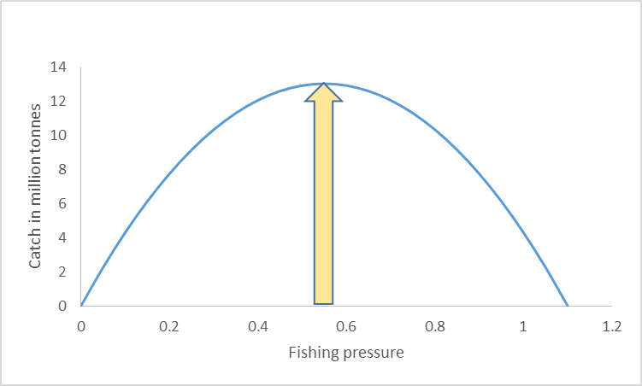
All fish stocks in the Northeast Atlantic – the true ecosystem Fmsy (yellow)
Towards Ecosystem Fmsy
Overfishing 1980s, 1990s and 2000s
Current single species

Slide 22
The gain can be obtained already in 2019
Present
EFmsy

Slide 23
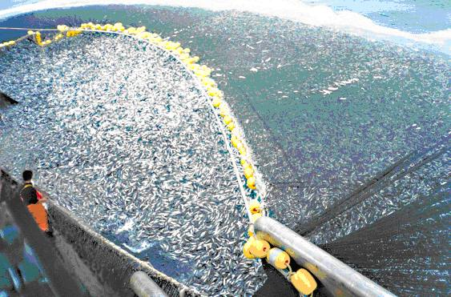
Thank you !

