Slide 1
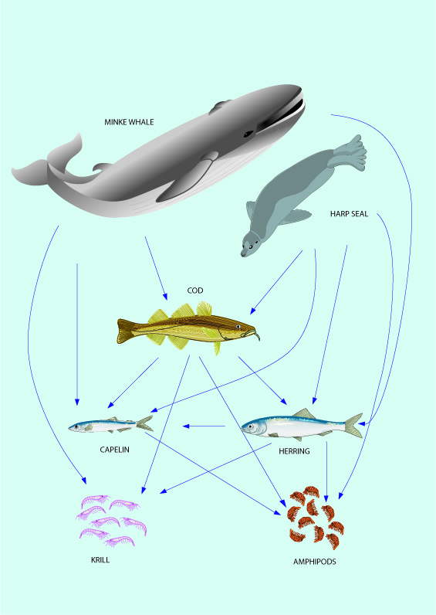

A list of ecosystem Fmsy values suggested for use in management of 53 North Atlantic fish stocks
Q:137
Henrik Sparholt, Bjarte Bogstad, Villy Christensen, Jeremy Collie, Rob van Gemert, Ray Hilborn, Jan Horbowy, Daniel Howell, Michael Melnychuk, Søren Anker Petersen, Claus Reedtz Sparrevohn, Gunnar Stefansson and Petur Steingrund.

Slide 2
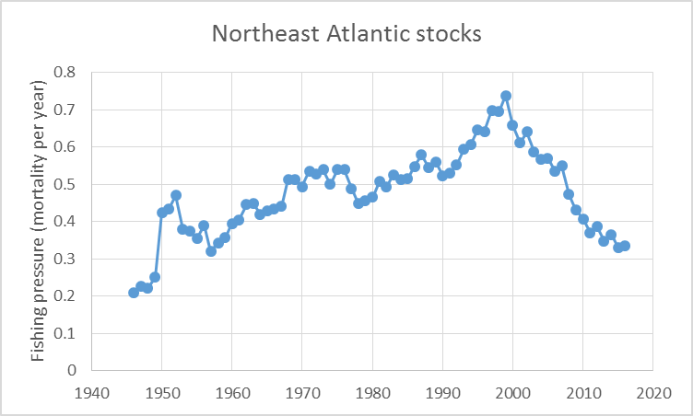
Background
Recent success of fisheries management
Fishing pressure reduced → stocks are building up → increased importance of stock interactions and ecosystem functioning a la density dependence
ICES Stabdard Graph Database 2018

Slide 3
Northeast Atlantic
Overfishing has ended
The major fish stocks in the EU Atlantic waters are rebuilding
Exploitation pressure currently aimed at: only 1/3 of what it was just 5-8 years ago.
The multispecies and ecosystem science tells us that this will be an under-exploitation.
The indications are (and the project will estimate it more precisely) that:
  F should only be reduced to 2/3 of the past level.
  Aiming for 2/3 in management will result in about 40% higher sustainable catch in the Northeast Atlantic (ICES area) corresponding to around 4 million tonnes per year worth 5 billion €*. – so quite important!
*https://ec.europa.eu/eurostat/statistics-explained/index.php?title=File:Landings,_2008_and_2016.png

Slide 4
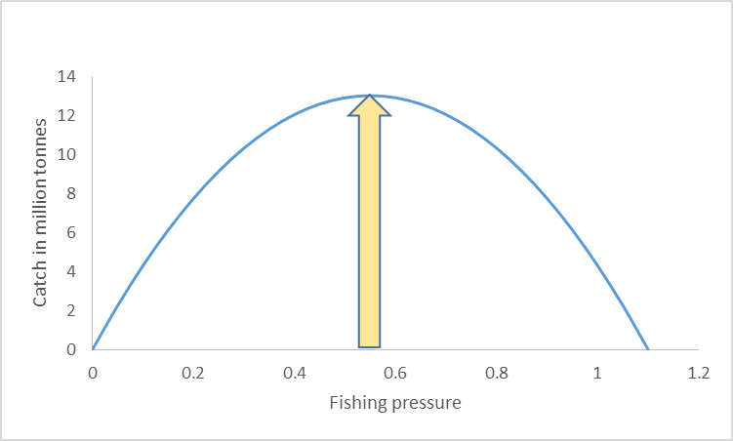
All fish stocks in the Northeast Atlantic – the true ecosystem Fmsy (yellow)
Towards Ecosystem Fmsy
Overfishing 1980s, 1990s and 2000s
Current single species

Slide 5
Urgent need for correction of management
Some stocks already rebuild:
  Mackerel, North Sea plaice, Northern hake, Northeast Arctic cod, Baltic sprat ...
Urgent need for correction – else foregone catch worth around 5 billion € – each year.
We are a dusin scientists with the needed expertise, ... try to contribute ... sat up the Fmsy project

Slide 6
”Fmsy project” - 2017-2018
Funding agencies:
  Nordic Council of Ministers
  EU-EMMF and Danish Ministry of Fisheries
  Norwegian Fisheries Research Fund
https://www.fmsyproject.net/

Slide 7
Objective
Come up with new Fmsy values based on ecosystem functioning:
  -- for the main ICES and some eastern USA data rich stocks

Slide 8
...by way of
  ”Bridging the gap” between science and scientific advice/management
  Bring multispecies and ecosystem science into Fmsy calculations

Slide 9
Baranov 1918, Graham 1947, Beverton&Holt 1957, Ricker 1958, Hilborn&Walters 1992, Longhurst 2010, and many others…
Longhurst, A. 2010. Mismanagement of marine fisheries. Cambridge University Press, Cambridge, UK:
” For any level of fishery harvest to be sustainable, some or all of the biological processes contributing to production must be compensatory, i.e. increasing as stock biomass decreases…”

Slide 10
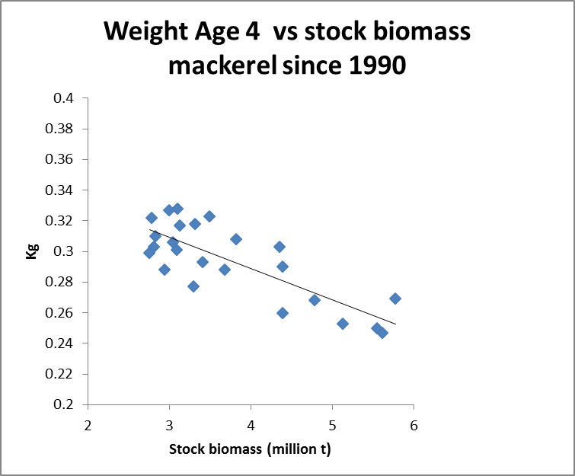
Example – growth

Slide 11
Four compensatory mechanisms –
Taken into account in current management?
Density dependent recruitment
Density dependent individual fish growth
Density dependent mortality
Density dependent maturity
√
Not yet
Not yet
Not yet
It is a mathematical fact that missing any of these in Fmsy calculations will give a downward bias!
Notes:
The way ecosystem functions in relation to fish is via Four compensatory mechanisms are important for fisheries management and fish stock dynamics:
DD r means that the number of juveniles produced each year is not increased infinitely when the stock size increase, at some stage a further increase in stock does give more juveniles – or put the other way around when a fishery starts on a pristine stock, the stocks decreases but the they still produce almost the same amount of juvenlies. So it compensates by producing more juveniles by female.
DD growth of individual fish also increases when the stock decreases – the improved growth in that way compensate to some extent for the reduced stock numbers
Same with mortality – the mortality decreasse as the stock decrease and thus more will survive and thus compensate for the reduction. Especially when we have to do with speces that are cannibals as cod are this can be quite important.
DD maturity fish mature at a younger age when the stock is small –

Slide 12
...and of course, scientific advice should be unbiased
ICES Strategic Plan 2014–2018:
” …commitment to maintain ICES as a strong and independent scientific organization in order to improve its capacity to give unbiased, sound, reliable, and credible scientific advice on human activities affecting, and affected by, marine ecosystems;”

Slide 13
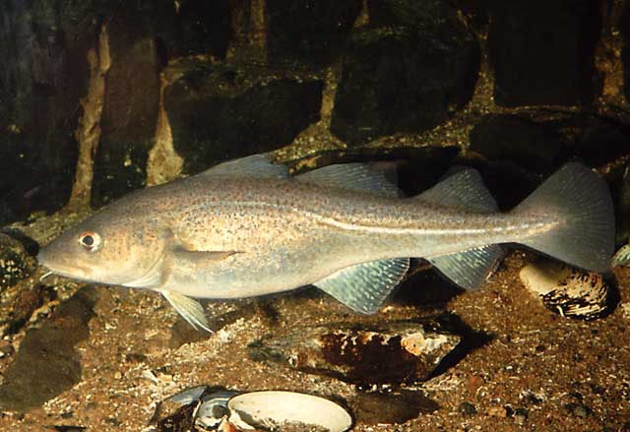
Example:
  Yield/SSB
  vs
  Fishing pressure
North Sea cod

Slide 14
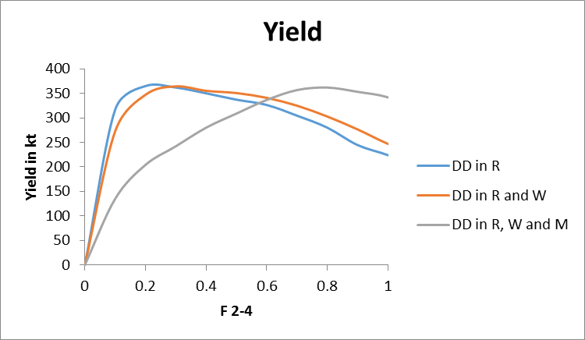
Example:
  Yield
  vs
  Fishing pressure
North Sea cod

Slide 15
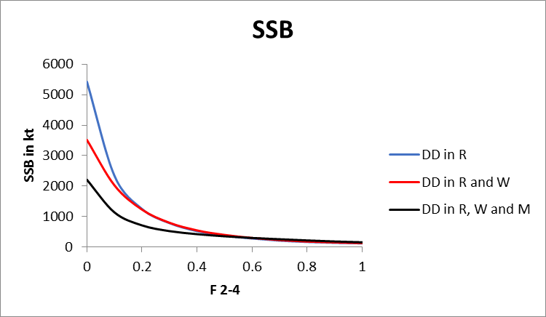
Example:
  SSB
  vs
  Fishing pressure
North Sea cod

Slide 16
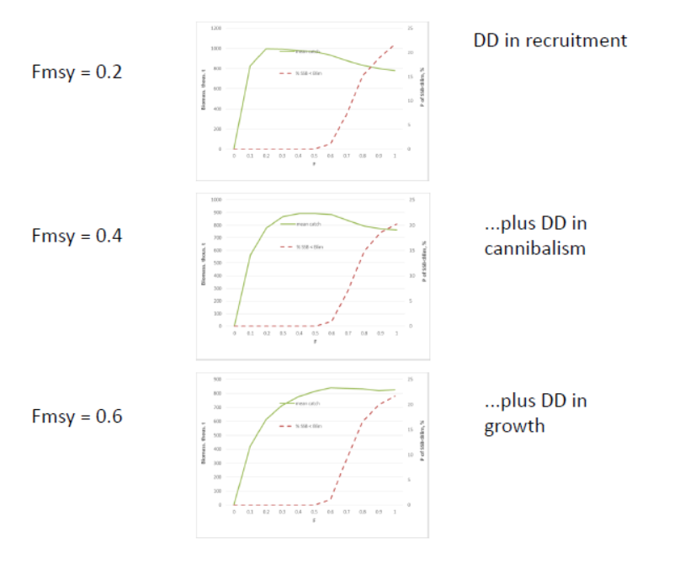
Example:
  Yield/SSB
  vs
  Fishing pressure
Northeast Arctic cod

Slide 17
Example:
Model | F msy | Variability in TAC by year according to Key-run | Catch according to Key-run ‘000 t | SSB according to Key-run ‘000t | TSB according to Key-run ‘000t
Key-run | 0.70 | 55% | 330 | 345 | 1170
Key-run without DD growth | 0.65 | 38% | 330 | 367 | 1193
Key-run without cannibalism | 0.55 | 24% | 323 | 429 | 1263
Key-run without cannibalism and DD growth | 0.40 | 15% | 305 | 568 | 1398
F current = 0.26 | - | 13% | 268 | 803 | 1620
Cod Iceland

Slide 18
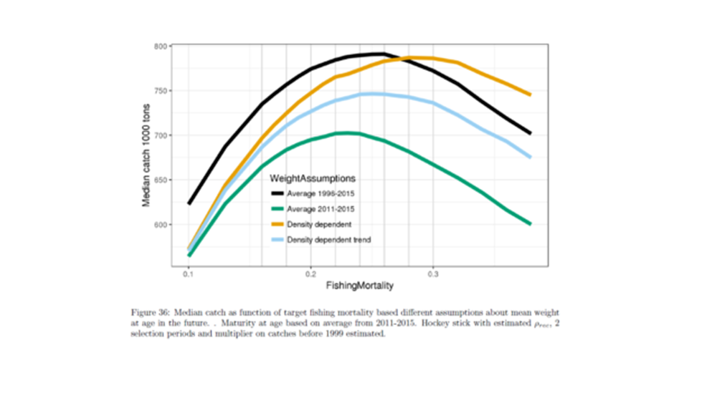
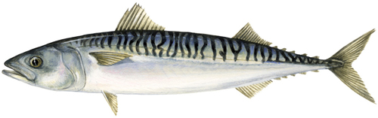
Example:
From ICES WGWIDE 2017
Mackerel

Slide 19
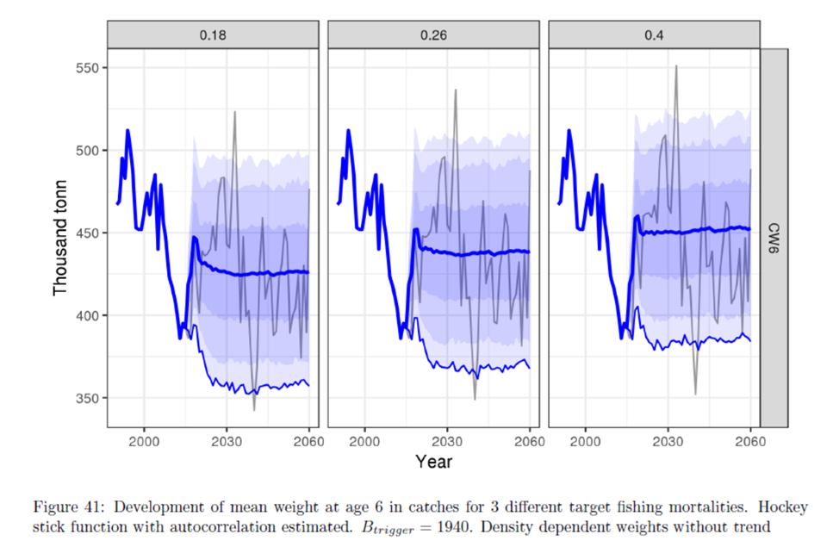

From ICES WKMACMSE_2017
Weight at age 6 in grams

Slide 20

Calculations from the Fmsy project based on a more statistically correct growth mode than ICES WKMACMSE_2017
Simulation scenarios | Fmsy | SSB at Fmsy kt | MSY kt | SSB with F=0 kt | TAC variability from year to year | Risk to get below Blim
No density dependence | 0.30 | 3300 | 730 | 8380 | 10% | <<5%
Density dependent growth | 0.40 | 2900 | 790 | 6890 | 11% | <<5%
Cannibalism low, but if included, will give an even higher Fmsy

Slide 21
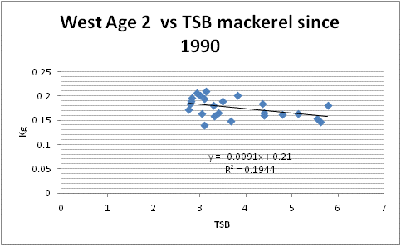
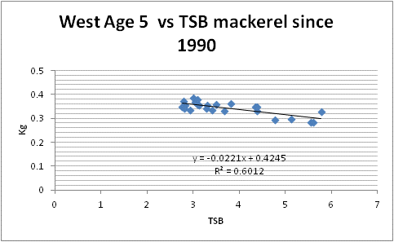
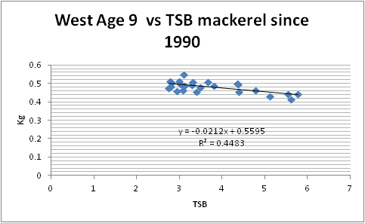
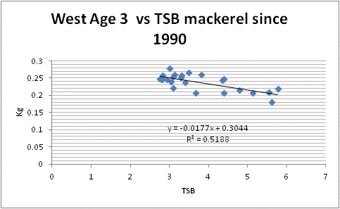
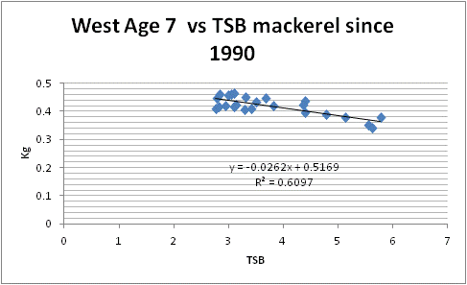
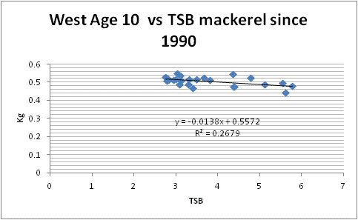
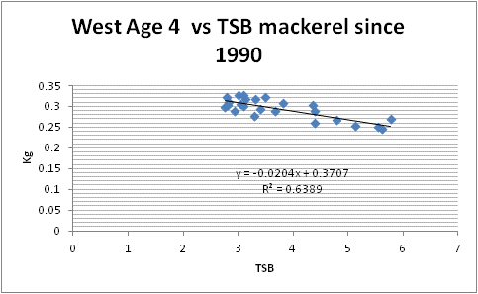
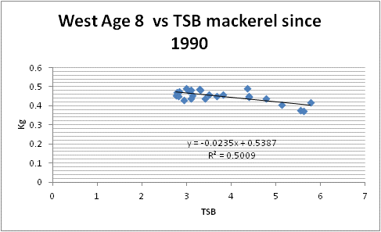
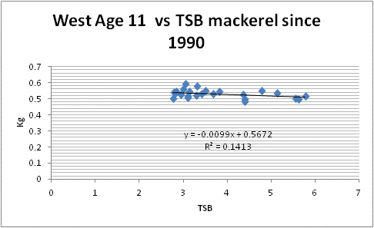

Density dependent growth

Slide 22
Three basic ideas
Multi-variate statistical approach to ”spread” the available ecosystem Fmsy values to all stocks
Use of Surplus Production Models - that implicitly includes all 4 density dependent elements - on the existing stock assessment time series of catch, F and SSB
Direct calculations based on established DD effects for a handfull of stocks

Slide 23
The SPM approach
Used assessment time series of annual catch and SSB (from e.g. ICES ”Summary table”)

Slide 24
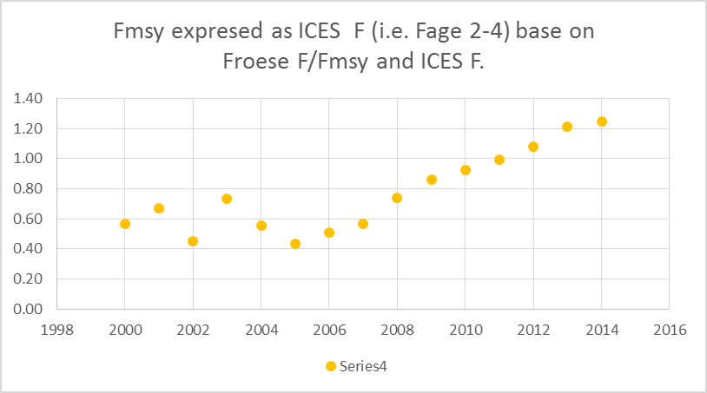
Fmsy /F (from SPM)
...multiplied by
F (from ICES)
=
Fmsy (in ICES F -”currency”)
F/Fmsy
SPM
1963 1975 1990 2015
F age 2-4
ICES assessment
1963 1975 1990 2015

Slide 25
Magnuson-Stevens Fisheries Conservation and Management Act (FCMA) (…and FAO, EU, …)
“…managers are required to use the best scientific information available…”.
And ICES:
“ICES advice … is based on the best available science and data…”
http://www.ices.dk/community/advisory-process/Pages/Basis-for-ICES-Advice.aspx

Slide 26
Available science in ecosystem functioning
  over four decades of intensive research
  hundreds of peer reviewed papers has been published
  more than 1.5 million fish stomachs analyzed
  hundreds of person-years spend on fish evacuation experiments
  a multitude of models developed.

Slide 27
Why wait another 40 years to use the obtained knowledge?
Let us pick the low hanging fruits now.
The need is urgent!

Slide 28
Like today, managers still do not need to consider the balance between species for using the proposed set of F_{MSY} values.
The project does not aim for a full multispecies approach, …but much closer to it than the current approach.
The focus will be on adding mainly density dependent growth, maturity and (if relevant) cannibalism, to the current single species way of estimating F_{MSY}.
The lack of full multispecies approach means that the new FMSY values should only be regarded as valid for say 5 years, before being renewed. Stock sizes can for this short time period be considered reasonable constant and thus species-interactions parameters as well.

Slide 29
 | ICES | Froese et al 2016 basis |  |  | RAM database
 |  |  |  |  | Schaefer | Thorson tax | Thorson pooled
Blue whiting | 0.32 | 0.37 |  |  | 0.27 | 0.27 | 0.25
Cod Icelandic |  | 0.63 |  |  | 0.50 | 0.49 | 0.50
Cod in divisions 7.e–k (western English Channel and southern Celtic Seas) | 0.35 | 0.56
Cod North Sea | 0.33 | 0.70 |  |  | 0.78 | 0.78 | 0.74
Cod Northeast Arctic | 0.40 | 0.55 |  |  | 0.48 | 0.49 | 0.48
Cod Faroe Plateau | 0.32 | 0.36 |  |  | 0.46 | 0.46 | 0.45
Cod Western Baltic Sea | 0.26 | 0.62
Haddock Icelandic |  | 0.47 |  |  | 0.43 | 0.43 | 0.43
Haddock Faroe | 0.25 | 0.28 |  |  | 0.30 | 0.30 | 0.30
Haddock Rockall | 0.20 | 0.31
Haddock Irish Sea | 0.27 | 0.41
Haddock VIIb-k | 0.40 | 0.87 |  |  | 0.86 | 0.86 | 0.88
Haddock North Sea | 0.19 |  |  |  | 0.56 | 0.56 | 0.61
Haddock Northeast Arctic | 0.35 | 0.43 |  |  | 0.36 | 0.36 | 0.35
Hake Northern | 0.28 | 0.82 |  |  | 0.41 | 0.41 | 0.38
Hake Southern | 0.25 | 0.59 |  |  | 0.51 | 0.51 | 0.50
Herring Western Baltic | 0.32 | 0.33 |  |  | 0.31 | 0.26 | 0.29
Herring Icelandic | 0.22 | 0.23 |  |  | 0.29 | 0.31 | 0.30
Herring N. Irish Sea | 0.26 | 0.43
Herring Celtic Sea and South of Ireland | 0.26 | 0.34 |  |  | 0.45 | 0.50 | 0.47
Herring North Sea | 0.33 | 0.58 |  |  | 0.26 | 0.28 | 0.27
Herring Gulf of Riga | 0.32 | 0.34 |  |  | 0.51 | 0.49 | 0.50
Herring 25–29, 32 xGoR | 0.22 | 0.21
Mackerel | 0.22 | 0.36 |  |  | 0.32 | 0.34 | 0.32
Plaice E Channel | 0.25 | 0.27 |  |  | 0.27 | 0.23 | 0.25
Plaice Kattegat Sund | 0.37 | 0.55
Plaice North Sea | 0.19 | 0.47 |  |  | 0.38 | 0.36 | 0.37
Saithe Icelandic |  | 0.31 |  |  | 0.30 | 0.30 | 0.29
Saithe Faroe | 0.30 | 0.37 |  |  | 0.36 | 0.36 | 0.35
Saithe North Sea etc. | 0.36 | 0.54
Saithe Northeast Arctic |  | 0.49 |  |  | 0.32 | 0.32 | 0.31
Sole Irish Sea | 0.20 | 0.18 |  |  | 0.27 | 0.23 | 0.26
Sole Eastern Channel | 0.30 | 0.48 |  |  | 0.69 | 0.80 | 0.73
Sole Western Channel | 0.29 | 0.26 |  |  | 0.21 | 0.18 | 0.20
Sole Bristol Chanel Celtic Sea | 0.27 | 0.31 |  |  | 0.44 | 0.51 | 0.47
Sole Kattegat | 0.23 | 0.38 |  |  | 0.28 | 0.26 | 0.27
Sole Bay of Biscay | 0.33 | 0.43 |  |  | 0.38 | 0.34 | 0.37
Sole North Sea | 0.20 | 0.38 |  |  | 0.41 | 0.45 | 0.42
Sprat Baltic Sea | 0.26 | 0.42 |  |  | 0.29 | 0.30 | 0.29
Surplus Production Models,

Slide 30
 | ICES |  | Multi-species |  | PROST-type
Blue whiting | 0.32
Cod Icelandic |  |  |  |  | 0.70
Cod in divisions 7.e–k (western English Channel and southern Celtic Seas) | 0.35
Cod North Sea | 0.33 |  | 0.87 |  | 0.70
Cod Northeast Arctic | 0.40 |  |  |  | 0.60
Cod Faroe Plateau | 0.32
Cod Western Baltic Sea | 0.26
Haddock Icelandic
Haddock Faroe | 0.25
Haddock Rockall | 0.20
Haddock Irish Sea | 0.27
Haddock VIIb-k | 0.40
Haddock North Sea | 0.19 |  | 0.58
Haddock Northeast Arctic | 0.35
Hake Northern | 0.28
Hake Southern | 0.25
Herring Western Baltic | 0.32
Herring Icelandic | 0.22
Herring N. Irish Sea | 0.26
Herring Celtic Sea and South of Ireland | 0.26
Herring North Sea | 0.33 |  | 0.50
Herring Gulf of Riga | 0.32
Herring 25–29, 32 xGoR | 0.22 |  | 0.35
Mackerel | 0.22 |  |  |  | 0.40
Plaice E Channel | 0.25
Plaice Kattegat Sund | 0.37
Plaice North Sea | 0.19
Saithe Icelandic
Saithe Faroe | 0.30
Saithe North Sea etc. | 0.36 |  | 0.33
Saithe Northeast Arctic
Sole Irish Sea | 0.20
Sole Eastern Channel | 0.30
Sole Western Channel | 0.29
Sole Bristol Chanel Celtic Sea | 0.27
Sole Kattegat | 0.23
Sole Bay of Biscay | 0.33
Sole North Sea | 0.20
Sprat Baltic Sea | 0.26 |  |  |  | 0.45
Ecosystem models and direct calculations including density dependence

Slide 31
Final set
Mean new Fmsy = 0.43
Mean ICES Fmsy = 0.28
Stock | ICES | Final new Fmsy values
Blue whiting | 0.32 | 0.32
Cod Icelandic |  | 0.56
Cod in divisions 7.e–k (western English Channel and southern Celtic Seas) | 0.35 | 0.63
Cod North Sea | 0.33 | 0.77
Cod Northeast Arctic | 0.40 | 0.56
Cod Faroe Plateau | 0.32 | 0.41
Cod Western Baltic Sea | 0.26 | 0.62
Haddock Icelandic |  | 0.45
Haddock Faroe | 0.25 | 0.29
Haddock Rockall | 0.20 | 0.31
Haddock Irish Sea | 0.27 | 0.41
Haddock VIIb-k | 0.40 | 0.87
Haddock North Sea | 0.19 | 0.58
Haddock Northeast Arctic | 0.35 | 0.39
Hake Northern | 0.28 | 0.61
Hake Southern | 0.25 | 0.55
Herring Western Baltic | 0.32 | 0.31
Herring Icelandic | 0.22 | 0.26
Herring Irish Sea | 0.26 | 0.43
Herring Celtic Sea and South of Ireland | 0.26 | 0.41
Herring North Sea | 0.33 | 0.46
Herring Gulf of Riga | 0.32 | 0.42
Herring 25–29, 32 xGoR | 0.22 | 0.28
Mackerel | 0.22 | 0.37
Plaice E Channel | 0.25 | 0.26
Plaice Kattegat Sund | 0.37 | 0.55
Plaice North Sea | 0.19 | 0.42
Saithe Icelandic |  | 0.30
Saithe Faroe | 0.30 | 0.36
Saithe North Sea etc. | 0.36 | 0.44
Saithe Northeast Arctic |  | 0.40
Sole Irish Sea | 0.20 | 0.22
Sole Eastern Channel | 0.30 | 0.61
Sole Western Channel | 0.29 | 0.23
Sole Bristol Chanel Celtic Sea | 0.27 | 0.39
Sole Kattegat | 0.23 | 0.32
Sole Bay of Biscay | 0.33 | 0.40
Sole North Sea | 0.20 | 0.40
Sprat Baltic Sea | 0.26 | 0.40

Slide 32
Preliminary results for 14 more stocks
Stock |  | ICES 2016 | Froese et al. SPM | Multispecies | Inferred from other stocks | Final
 |  | a | b | c | d | e
Cod W Scotland | 1 | 0.17 |  |  | 0.69 | 0.69
Cod Irish Sea | 2 | 0.37 | 0.95 |  |  | 0.95
Cod Eastern Baltic Sea (pre 2012) | 3 | - | - | 0.87 |  | 0.87
Herring W Scotland and W Ireland | 4 | 0.16 | 0.22 |  | 0.39 | 0.30
Herring Norwegian SSP | 5 | 0.15 | - |  | 0.26 | 0.26
Herring Bothnian Sea | 6 | 0.15 | - |  | 0.34 | 0.34
Horse mackerel W | 7 | 0.13 | - |  | 0.37 | 0.37
 |  |  | Surplus Production Models |  |  | Final
 |  |  | Schaefer | Thorson tax | Thorson pooled
 |  |  | Model 5 | Model 7 | Model 8
Blue ling Vb-VI-VII | 8 | 0.12 | 0.18 | 0.18 | 0.19 | 0.18
Tusk Va and XIV | 9 | 0.226 | 0.15 | 0.15 | 0.14 | 0.15
Golden Redfish V-VI-XII-XIV | 10 | 0.097 | 0.11 | 0.13 | 0.11 | 0.12
Megrim (L. whif.) in divisions 7.b–k, 8.a–b, and 8.d | 11 | 0.19 | 0.53 | 0.59 | 0.55 | 0.55
Ling Iceland Grounds | 12 | 0.284 | 0.43 | 0.44 | 0.38 | 0.42
Atlantic menhaden | 13 | - | 0.76 | 0.74 | 0.75 | 0.75
Summer flounder Mid-Atlantic Coast | 14 | - | 1.08 | 1.12 | 1.10 | 1.10
Footnotes.
1d. Mean of cod in Irish Sea, in divisions 7.e–k (western English Channel and southern Celtic Seas), the North Sea, and Faroe Islands (0.95, 0.63, 0.77, 0.41) equal to 0.69.
3c. Most complete model: Multispecies FMSY Gislason (1999). The options assuming constant relationship in F between the three stocks (that of 1996).
4d. Mean of Herring Icelandic, Herring Irish Sea, Herring Celtic Sea and South of Ireland, Herring North Sea, (i.e. 0.26, 0.43, 0.41, and 0.46) equal to 0.39.
4e. Mean of the two values
.
6d. Similar to Icelandic herring.
7d. Average of herring in western Baltic (0.31), herring in Guld of Riga (0.42) and herring 25–29, 32 xGoR (0.28).
8d. Assumed equal to mackerel due to similar growth and maximum age.

Slide 33
Urgent actions needed – about 4 million t of catch is foregone each year!
Towards Ecosystem Fmsy
Current single species

Slide 34
We see a problem with the current Fmsy values – they are biased downwards.
There are probably several ways to rectify it ...but it is pretty urgent
We propose this set of Fmsy values - that has no bias known to science
If ICES choose to use them – it is very easily done....

Slide 35
”Business as usual” except with new Fmsy values
-- still use the ICES HCR – so the risk to stock collapse very small !!
Present Fmsy
New Fmsy

Slide 36
Symposium in Copenhagen 10-11 October – to discuss it further
Sign up!!

Slide 37
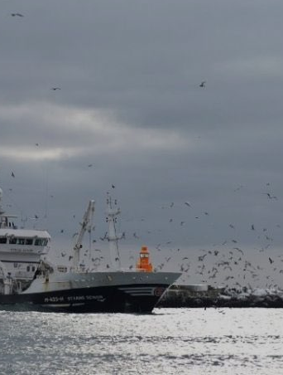

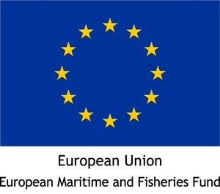



Symposium
Optimizing sustainable fishing yields - ecosystem and management perspectives
Fish stocks in the North Atlantic are rebuilding, calling for exploitation that ensures ecological, social and economic sustainability. Technically, this calls for exploitation at the level that gives maximum sustainable yield (MSY), but how should this be estimated?
A working group of the Nordic Marine Think Tank (NMTT) has evaluated the question, and will along with invited scientists, stakeholders and managers present and discuss MSY reference points.
Scientists, managers, industry and the general public are welcome.
Venue: DGI BYEN, Copenhagen, Denmark.
13:00, 10 October to 13:00, 11 October, 2018.
Register at fmsy.eventbrite.com
A scientific symposium organized by the NMTT and the “Fmsy-project”: www.fmsyproject.net

Slide 38
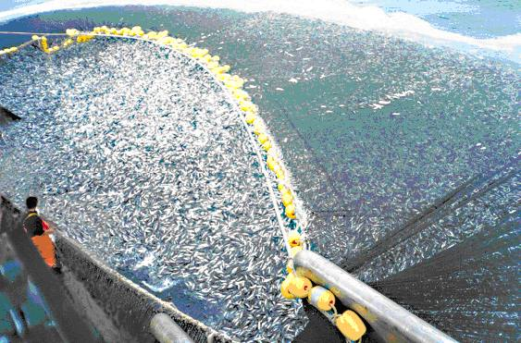
Thank you !

Slide 39
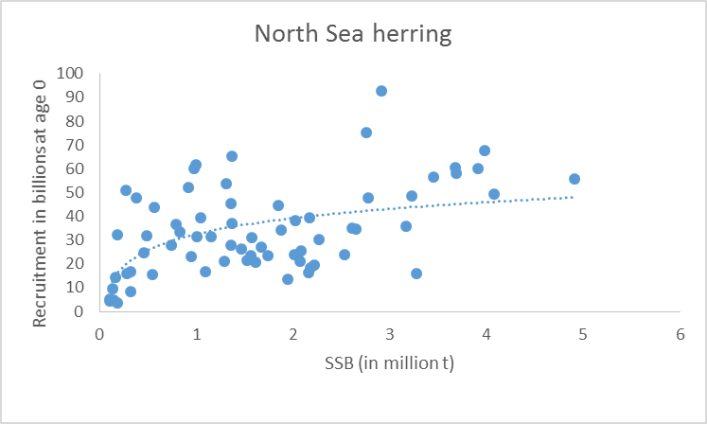
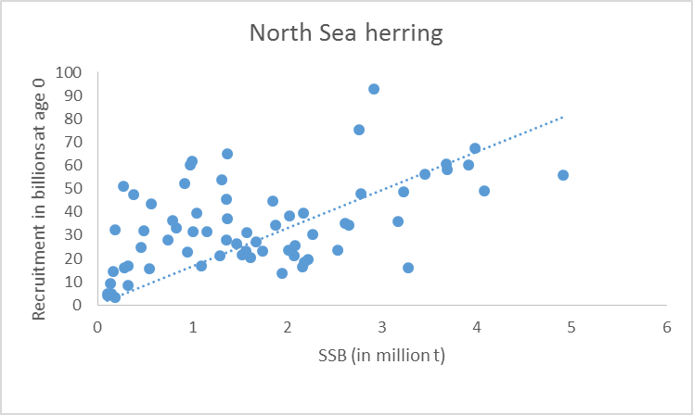

Why does DD gives higher Fmsy ?
– an illustration
If this was the truth out in the sea – then stop fishing – the stock will build up – recruitment will be larger and larger – build up the stock more and so on
---Fmsy will be very small, actually you should wait 1000 years and you could walk on herring from Denmark to England
Of course this is not a good model – you need DD
Notes:
Remember this is an animation

Slide 40
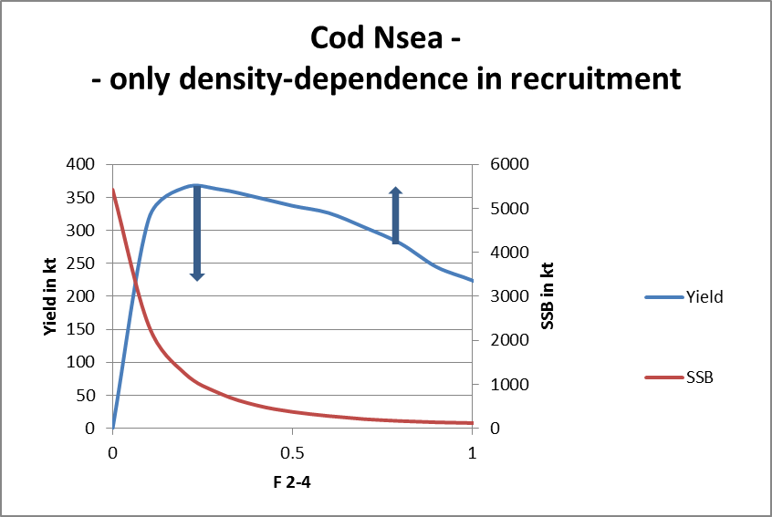
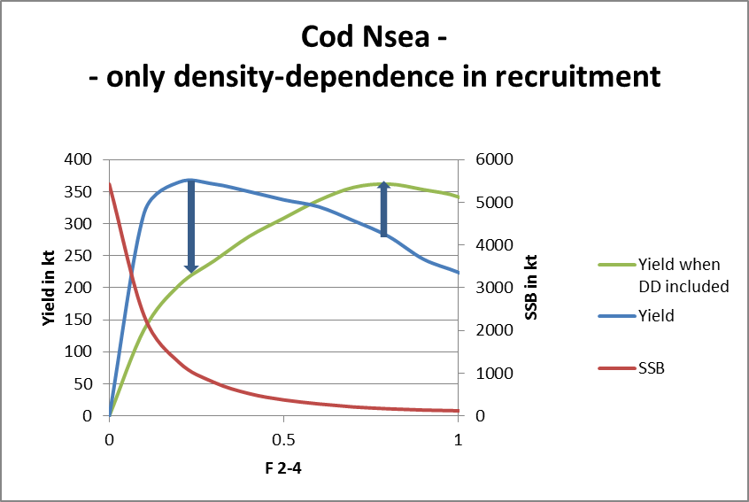
A more technical explanation...
Yield is No of individuals caught times their weight
If we include the right weight for a given SSB the calculated yield at a high SSB will go down and the yield for a low SSB will go up
...this will give the green curve – and a higher Fmsy

Slide 41
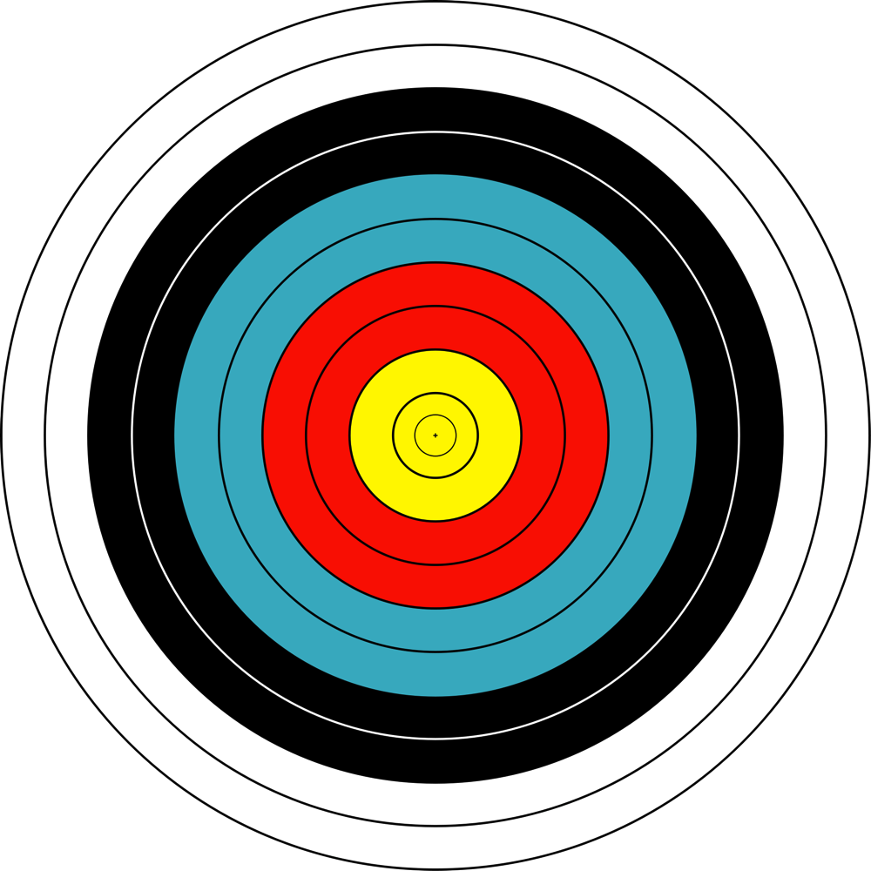
...and it is better to be unprecise and unbiased than precise and biased!

Slide 42
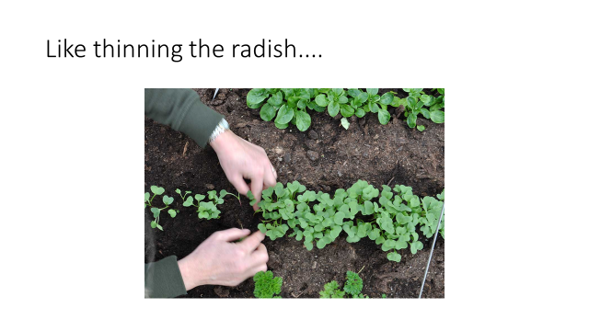
Density dependence is...

